Slide 1


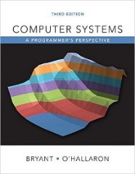
System Level Programming
Lab of Garbage Collection
李靓 Jing Li lijing712@scu.edu.cn
School of Computer Science / Software Engineering

Slide 2
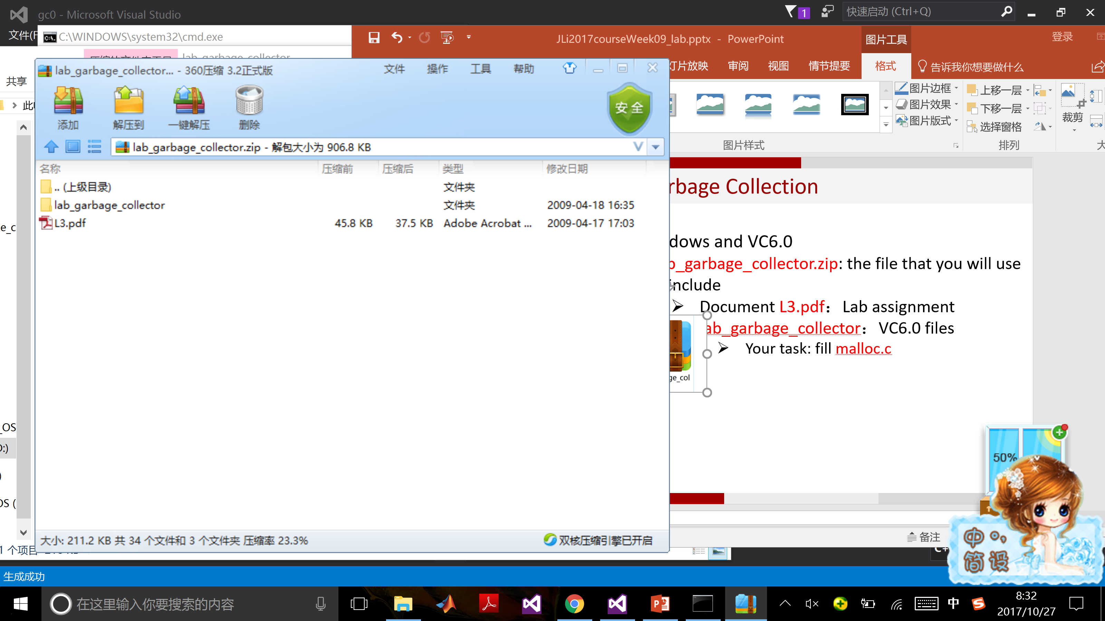
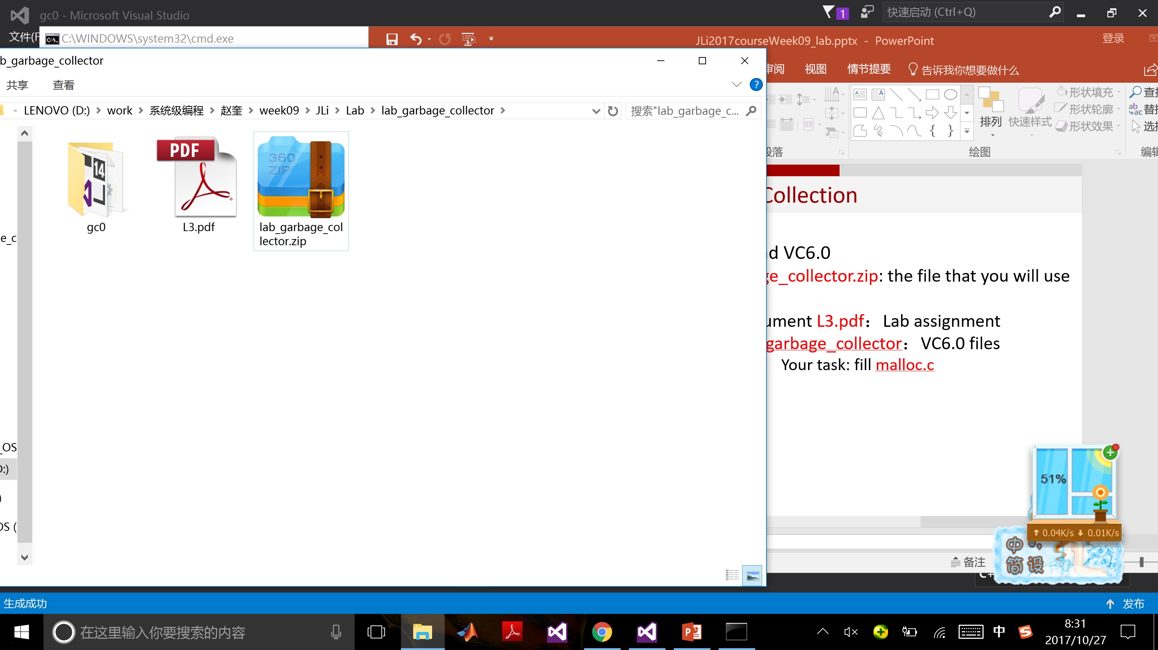
Lab of Garbage Collection
For Windows and VC6.0 / VS
The file that you will use
Document L3.pdf：Lab assignment
lab_garbage_collector：VC6.0 files
[Your task] Fill malloc.c by realizing garbage_collect()

Slide 3
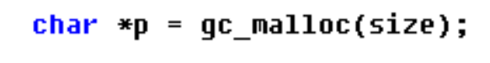
Functionality of the program [main() in driver.c]
Read test data from .rep file, which is used for allocating and free spaces
correctness() test correctness of your garbage collector
speed() test speed of your garbage collector
Garbage collection based malloc operation

Slide 4
When to call garbage_collect()
gc_malloc()分配内存时
(1) $freelist−>size≥ s$: 分配
(1) 𝑓𝑟𝑒𝑒𝑙𝑖𝑠𝑡−>𝑠𝑖𝑧𝑒≥ 𝑠: 分配
(2) 若不满足(1): garbage_collect()
(3) 若不满足(2): mem_sbrk()

Slide 5
Our task
确定何时调用garbage_collect()
从栈、寄存器、(全局变量)中寻找Root
Mark通过Root能够到达Heap的节点
Sweep所有未标记的节点
Tree
Stack_t
List_t

Slide 6
The whole procedure
Freelist
Alloc_tree
Freelist
Garbage collect
FREE
ALLOC
Stack

Slide 7
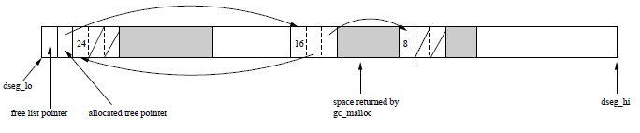
How the space is organized
Free list
freelist = (char*) dseg_lo;
Allocated tree
alloc_tree = *(Tree **)(dseg_lo+sizeof(long));

Slide 8
Our task
确定何时调用garbage_collect()
从栈、寄存器、(全局变量)中寻找Root
Mark通过Root能够到达Heap的节点
Sweep所有未标记的节点

Slide 9
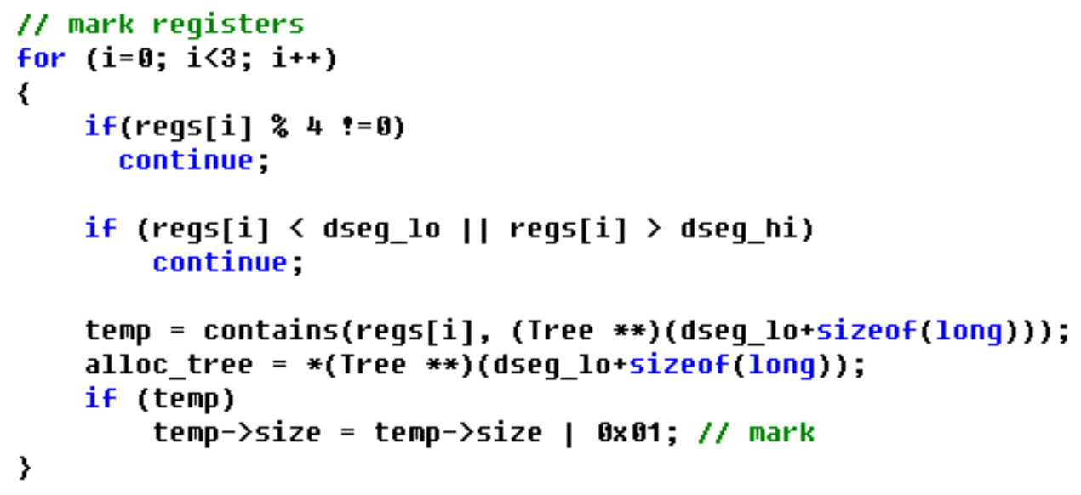
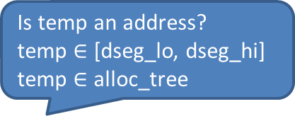
Root pointer in register
通过void garbage_collect(int *regs, int pgm_stack)函数形参*regs获得
Is temp an address?
temp $∈$ [dseg_lo, dseg_hi]
temp $∈$ alloc_tree

Slide 10
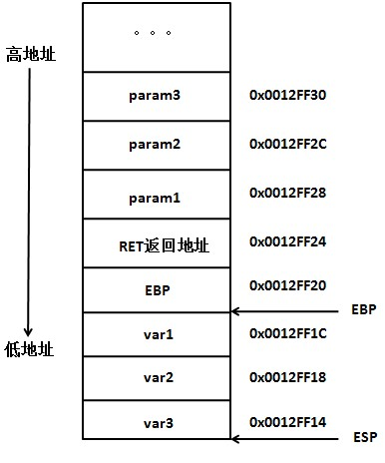
Root pointer of the stack
通过宏定义PGM_STACK_TOP获得当前ebp值，ebp里面保存的是调用函数的ebp，这样可一直向上访问到main()对应的栈空间
main
fun

Slide 11
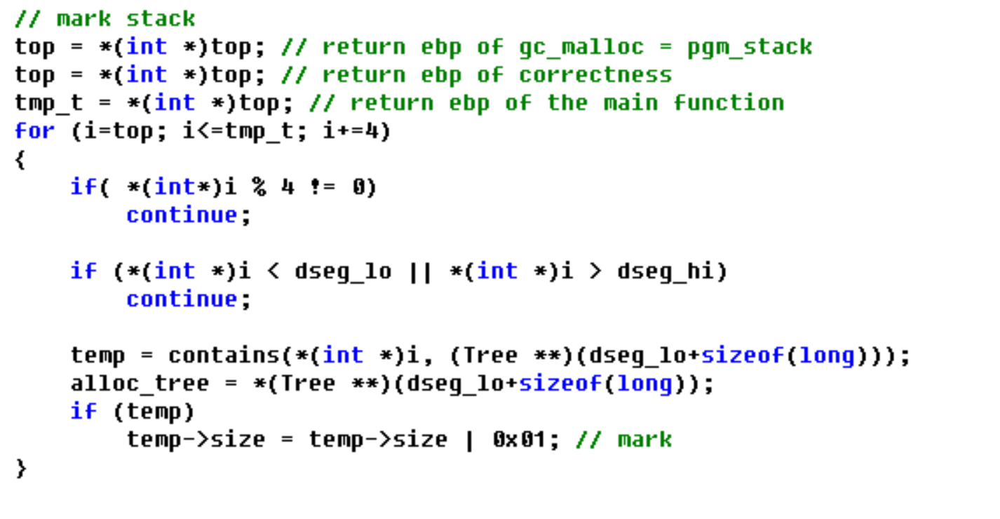
Root pointer of the stack
通过宏定义PGM_STACK_TOP获得当前ebp值，ebp里面保存的是调用函数的ebp，这样可一直向上访问到main()对应的栈空间

Slide 12
Our task
确定何时调用garbage_collect()
从栈、寄存器、(全局变量)中寻找Root
Mark通过Root能够到达Heap的节点
Sweep所有未标记的节点

Slide 13
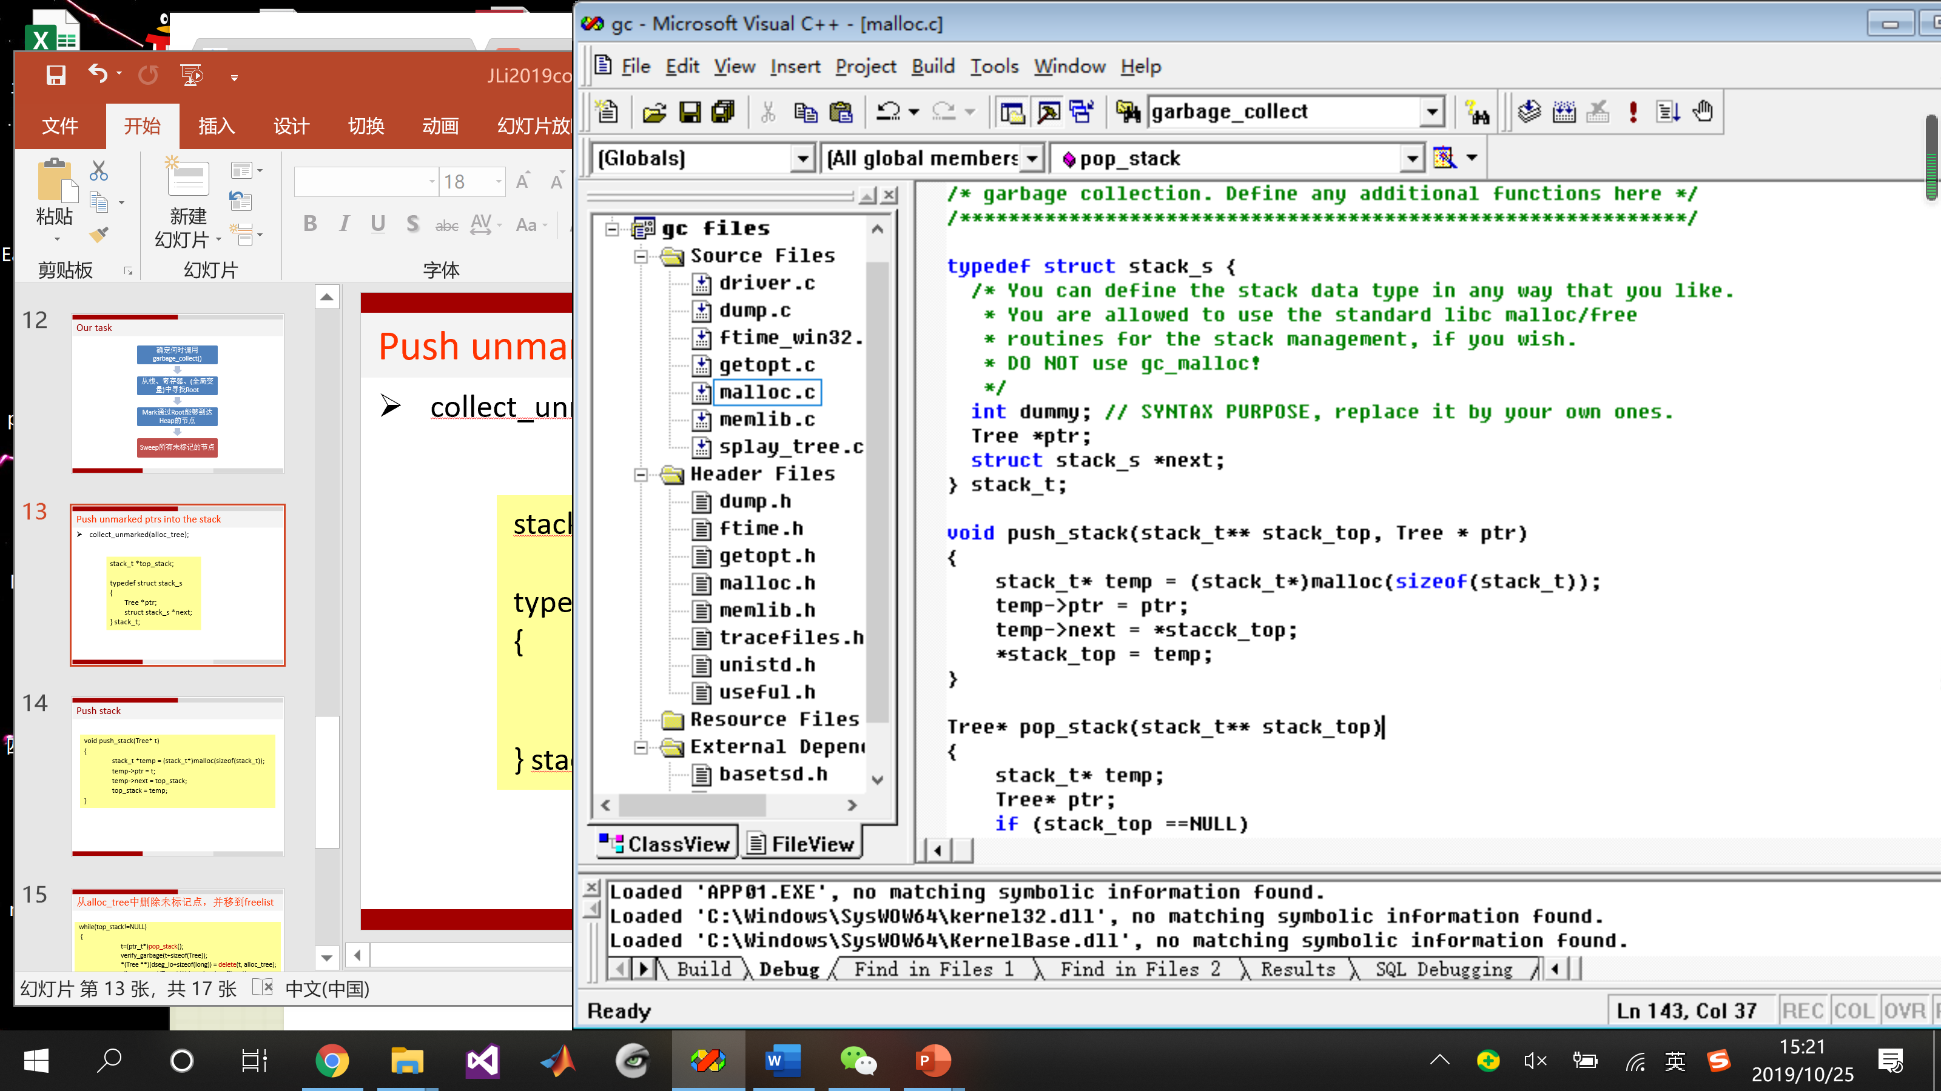
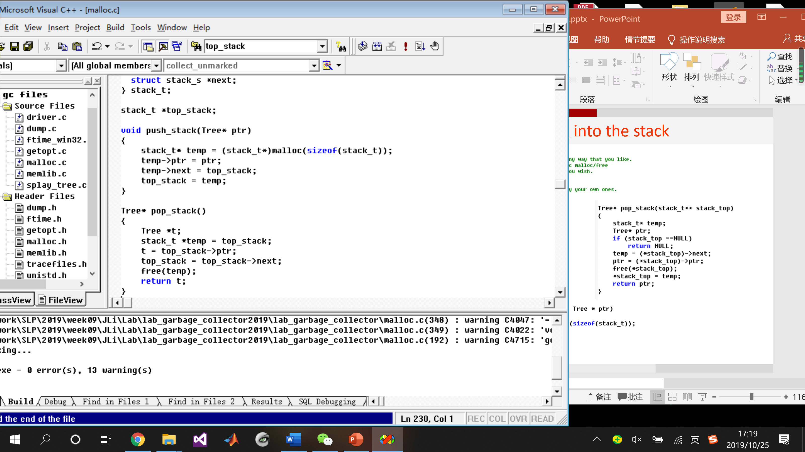
Push unmarked ptrs into the stack

Slide 14
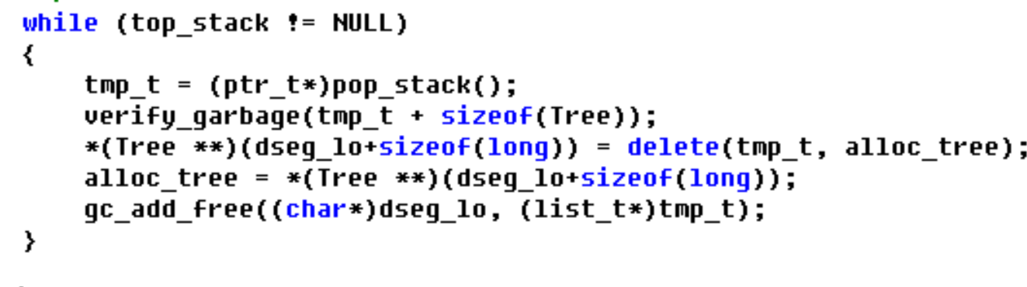
Delete allocated node and add it to free list

Slide 15
Sum up
studentID_Name_week09.rar
Including
lab_garbage_collector Your project folder
ReadMe.doc

